Slide 1
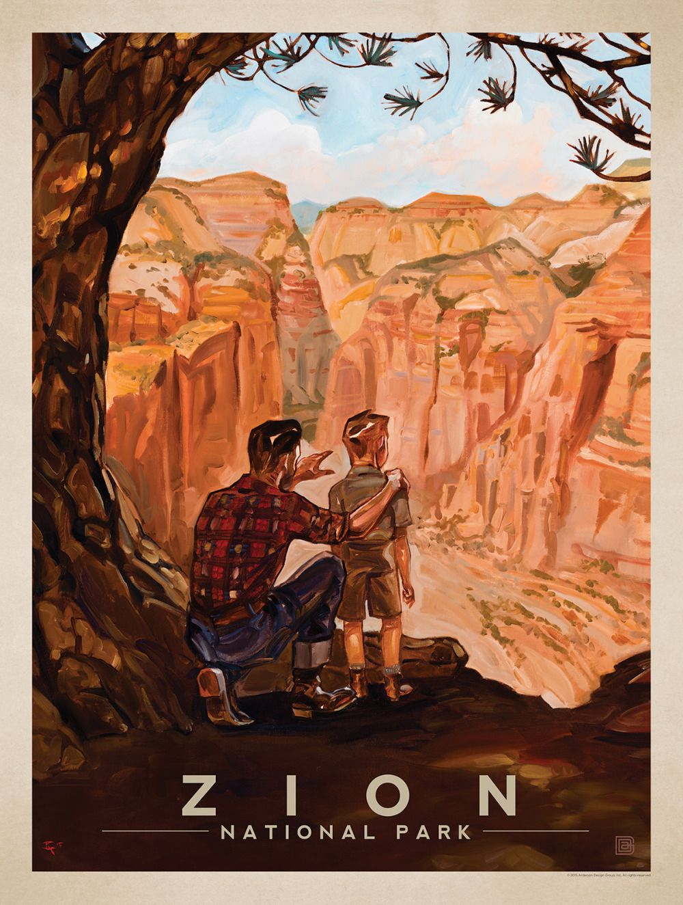
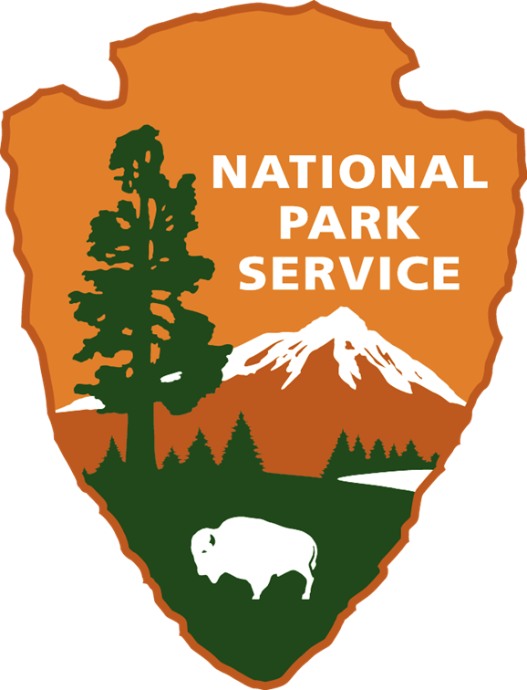
Title Slide
Notes:
Throughout the world the terrain--or shape of the land--looks very different. There are many National Park Service sites throughout the nation, many protected because of their terrain and what lies within. One of those sites is Zion National Park, located in southwestern Utah. This park is an excellent example of beautiful landscapes and extreme topography.

Slide 2
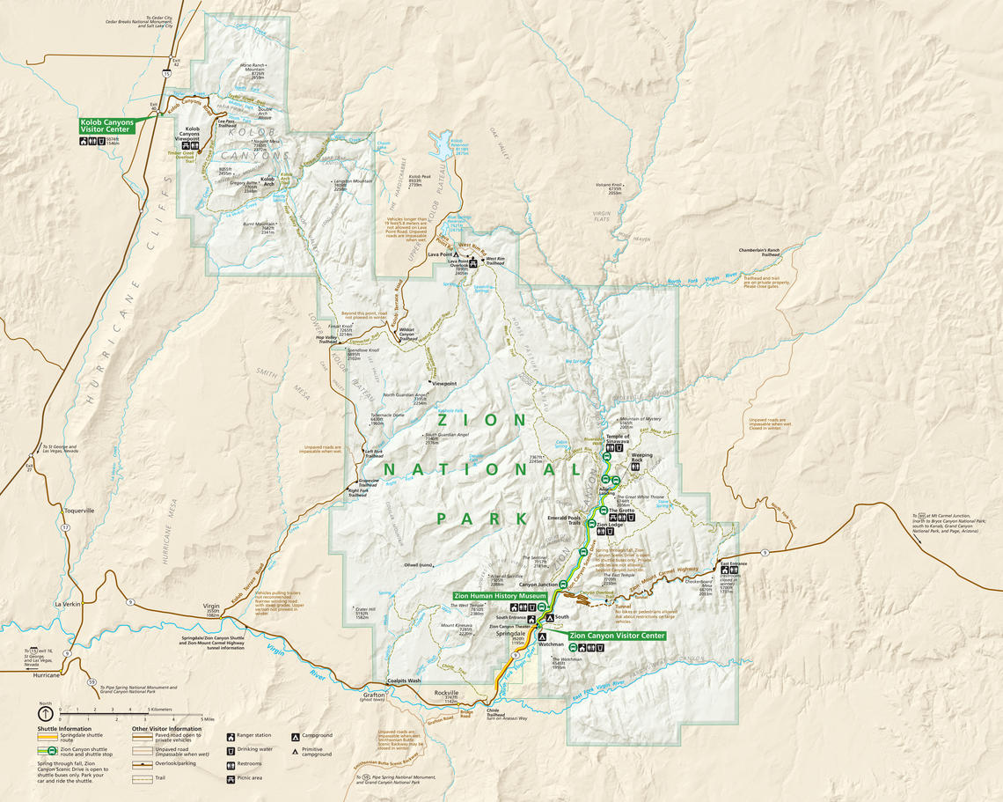
Zion National Park Map
Notes:
This map of Zion National Park gives us a simplified idea of Zion’s dramatic scenery. It does not communicate a true idea of what the land looks like in person. Just by looking at this map, could you tell someone what Zion looks like? Or plan the best route to walk from one area to another? Or decide where the best place to build a new campground?
It can be a challenge, but reading information (data), understanding it, and then using it is such an important skill to have. Map reading is one way to learn this and it is really helpful in real life.

Slide 3
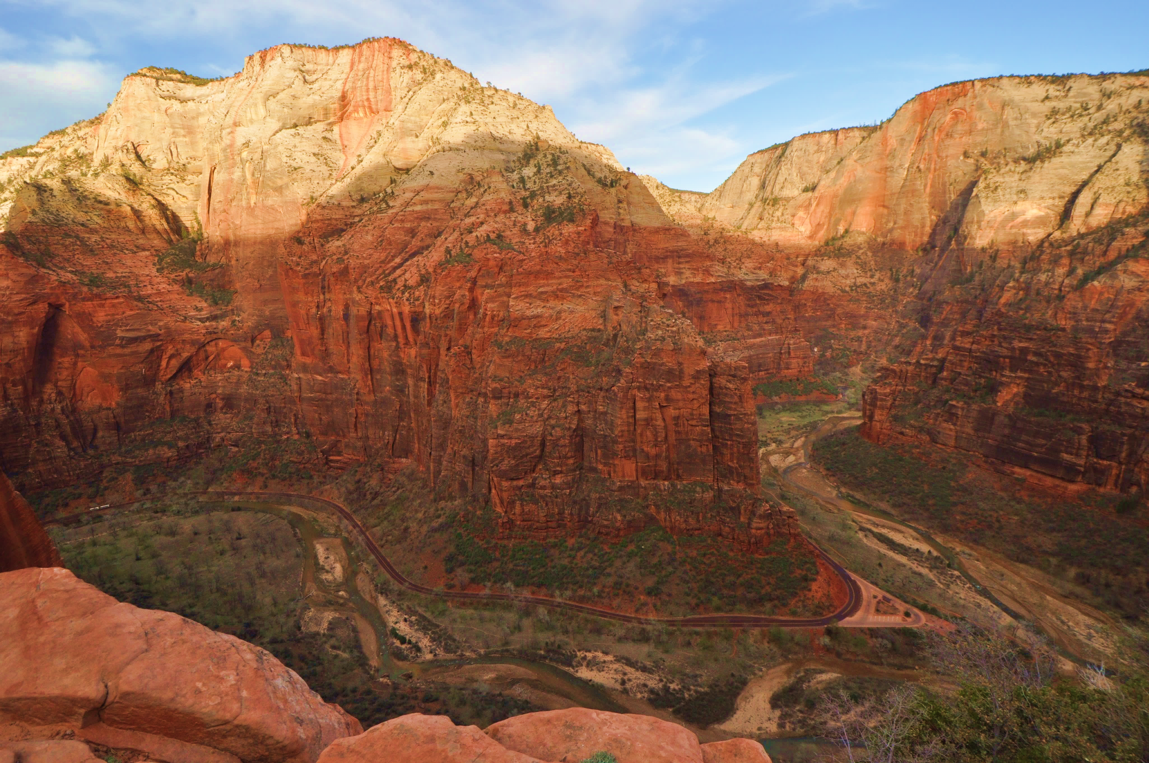
Big bend view point
The surface of our planet is full of land features.
Land Features:
Mountains
Canyons
Arches
Craters
Hills
Rivers
Lakes
Seas
And more
Notes:
The surface of Earth has land features that give locations their “look”. Look out your window. What do you see?

Slide 4
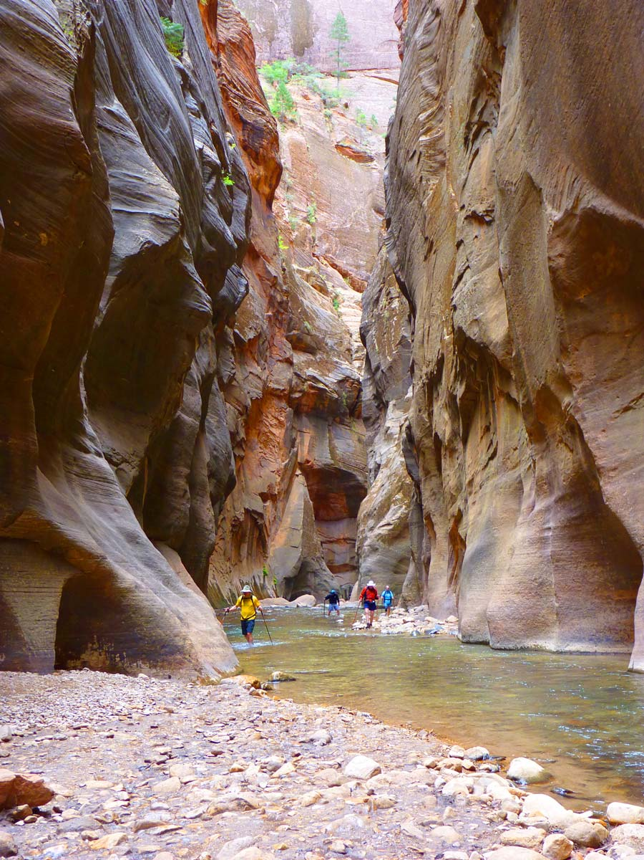
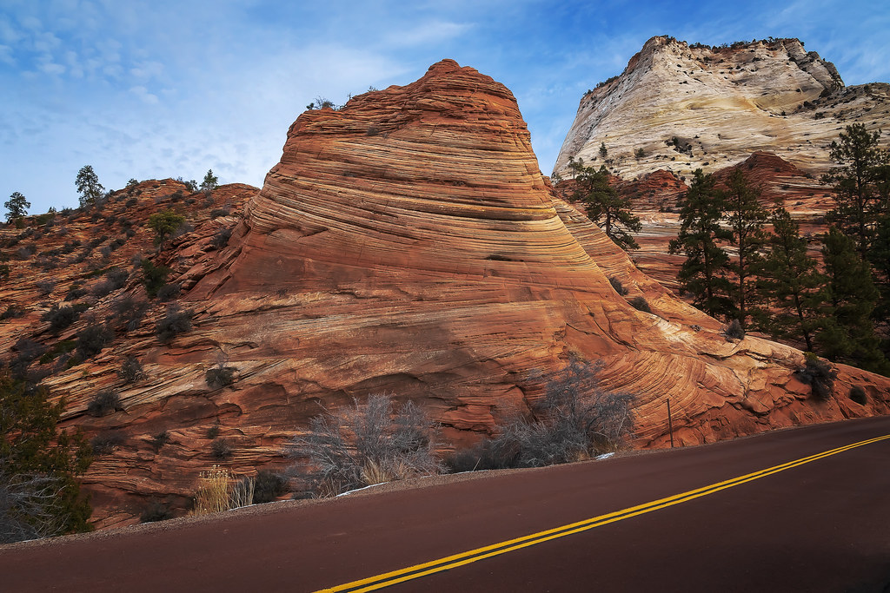
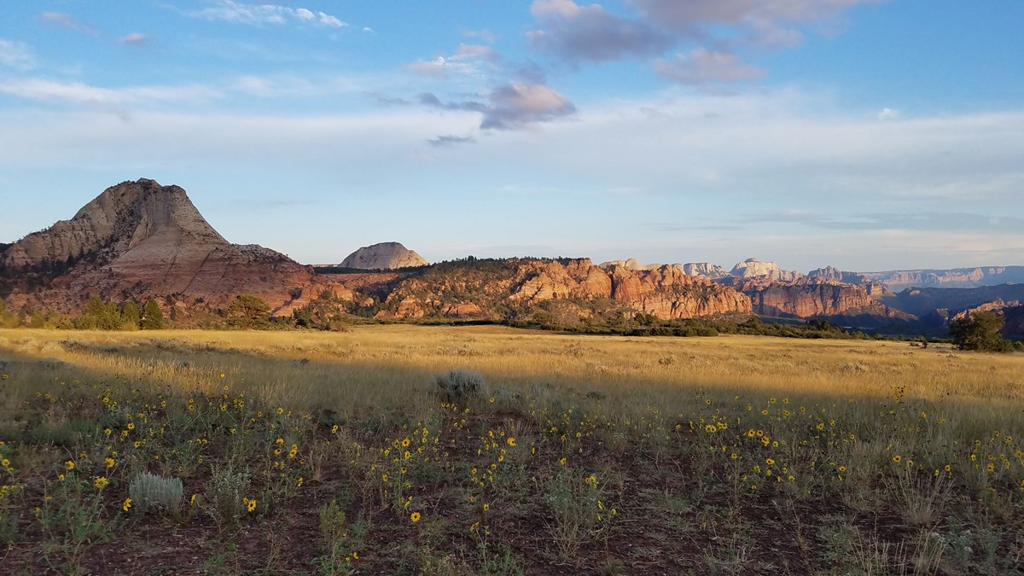
Zion’s Landforms
NPS PHOTO
Topography studies the shape of the land’s surface.
NPS PHOTO
Notes:
Topography is the study of the shape of the land’s features or surface. This includes the height and shape of the rocks and mountains. These photographs show some of the different shapes the land in Zion can have. There are high points, low points, and places in between.

Slide 5
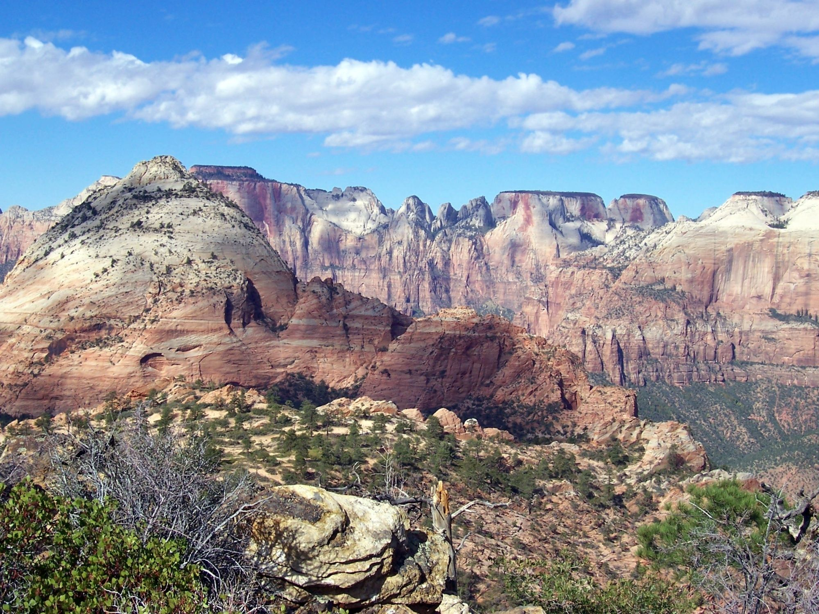
Canyon Vista
Notes:
When topographers study the land and create topographic maps they also study the geology of the place. Much of the rocks and cliffs of Zion National Park are made up of a sedimentary rock called sandstone. These tall cliffs were once ancient sand dunes that hardened into rock over time. Notice the different heights of the cliffs.

Slide 6
Elevation- the height of the land
7,800 ft
5,800 ft
5250 ft
4,720 ft
4,000 ft
Notes:
Elevation is the height of the land. As you can see, some areas are high elevation and others are thousands of feet lower. The varied elevations here are at different locations through Zion National Park. At the highest elevations in Zion, we have conifer forests. At the lowest, we have deserts filled with cacti. The elevation of a location greatly influences the ecosystem found there.
What is the lowest elevation you see in this photograph?
What elevation in this photograph would you expect to find tall pine trees (conifers)?

Slide 7
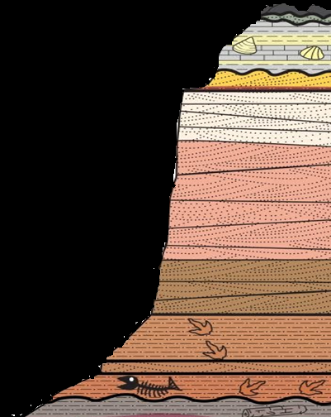
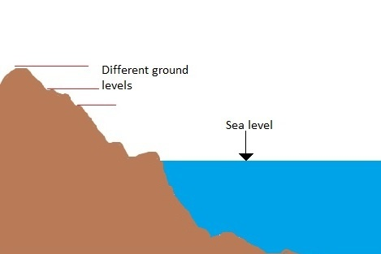
Elevation = height above or below sea level
Notes:
Even though Zion National Park is far away from the coast, elevation is always measured in units above or below sea level (usually in feet or meters). Sea level is used by mapmakers throughout the world to have an accurate measurement of mountains, valleys, and other landforms. By comparing different points of elevation throughout a landscape, we can get a better idea of the topography—or the shape--of the land. Unless you have personally walked all over a landscape, it can be challenging to visualize its features’ specific shapes and elevations. In order to better do this, topographic maps were invented.

Slide 8
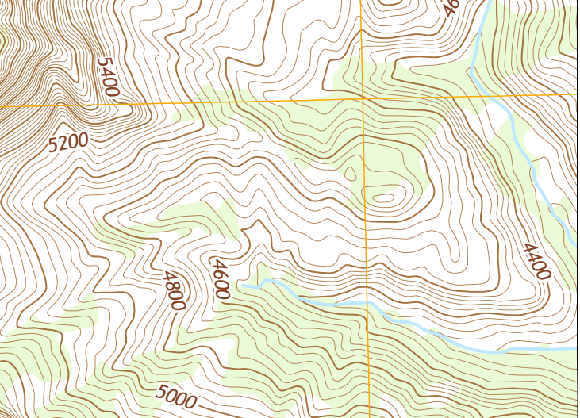
Topographic maps show elevation change on a flat piece of paper or screen.
Notes:
Topographic maps show elevation change on a flat piece of paper or screen. It’s like going from 2D to 3D. The photograph on the right is a real place in Zion. The map to the left is a simple topographic map of this same location. To read the map, imagine you are looking at this photo or place from above- like a flying bird. What are some things you notice about this topographic map?

Slide 9
A contour line is a line on a map joining points of equal elevation.
Notes:
Topographic maps always have contour lines. A contour line is a line on a map joining points of equal height above or below sea level. Place your finger on any line found on this map. Follow this line up and around until it runs off the page…all of the land represented along this contour line you just traced is the same elevation or height. The job of contour lines is to let the map reader know the varied height or elevation of land.

Slide 10
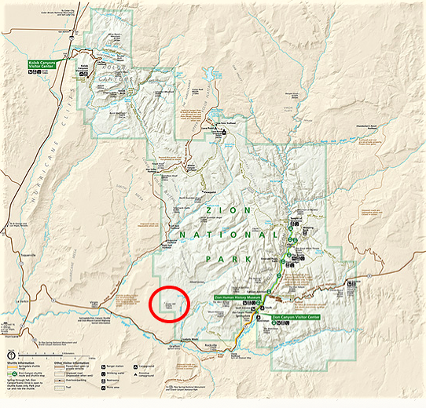
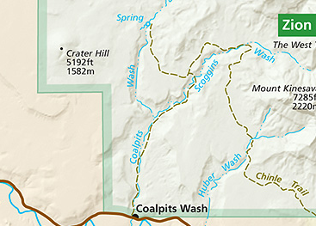
Zion National Park map 2
Notes:
Is this a topographic map? No, this map of Zion is not a topographic map as there are no contour lines. However, we can use it to locate a unique land feature in Zion. Find the circled area on the map. This is the location of Crater Hill, an inactive cinder cone volcano. Although Zion is most famous for its soaring sandstone cliffs, we also find evidence of volcanic activity and rocks. In this southwest corner of Zion National Park there are a number of other cinder cones. This area of ancient volcanic activity is called the Kolob Volcanic Field by geologists. Why has there been so much volcanic activity in this one area? Geologists say it is because the crust in this location has many fractures. These fractures allow magma to rise up and reach the surface of the earth more easily.

Slide 11
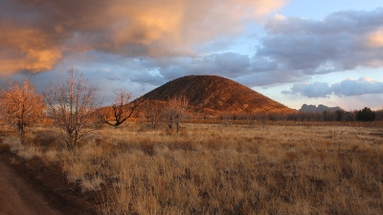
Crater Hill
Notes:
This is a photograph of Crater Hill that you just found on the map. This volcano erupted approximately 120,000 years ago. When hot lava erupted high into the air, these “drops” of lava encountered cool air, they became small hole-filled rocks called cinders. The cinders (igneous rock) fell down to the ground and collected around the vent (hole). The collection of cinders around the volcanic vent formed a cone or hill like you see in this photograph. That’s why these types of volcanoes are called cinder cones! They’re literally a cone made from cinders.
Now, let’s look at a topographic map of Crater Hill.

Slide 12
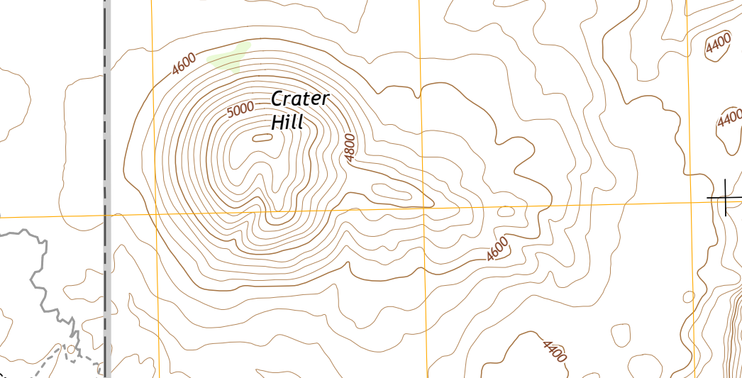
Crater hill map
Longitude
Latitude
USGS MAP
Notes:
This shows us a topographic map of Crater Hill! Remember, it represents what the area would look like if you were flying above and looking down.
Like other map types, it shows us borders, latitude, and longitude. However, the added contour lines will help us know more about what Crater Hill actually looks like without having a photograph. Find the darker contour line with 5000 on it. What do you think this line tells the map reader?

Slide 13
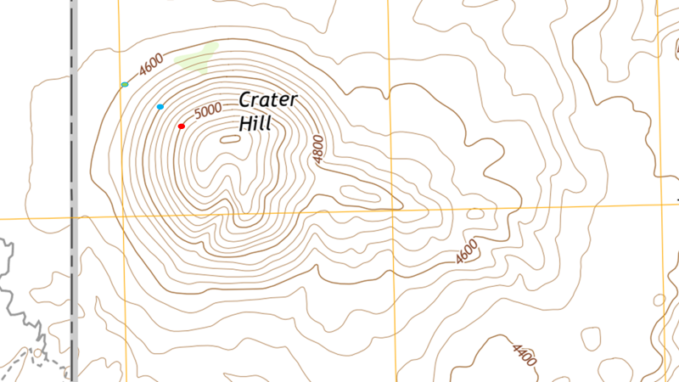
Index Contour Line
USGS MAP
Notes:
This darker contour line and others like it are called index contour lines. As you can see, they are labeled and show Crater Hill’s elevation in feet above sea level at that spot.
What if we want to know the height of the other contour lines that are not bold and do not have an elevation listed? Take a minute to study the contour lines here. Do you see a pattern?

Slide 14
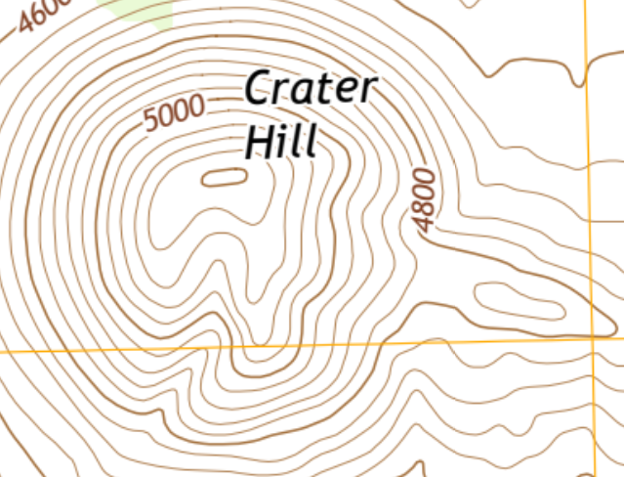
Contour Interval
B
A
5000 ft – 4800 ft = 200 ft
1
2
3
44
5
USGS MAP
Notes:
Let’s practice using this map with a scenario:
You are standing on point A and will walk to point B. How much elevation will you lose walking there?
Point A is on a dark index contour line that is at an elevation of 5000 ft.
Point B is on a dark index contour line that is labeled 4800 ft.
Simply subtract the elevation of your ending point (B) from your starting elevation at point A. 5000 feet – 4800 feet = 200 feet elevation loss
Are you walking uphill or downhill? downhill

Slide 15
Contour interval 2
5000 ft – 4800 ft = 200 ft. total elevation loss
200 ft / 5 contour lines = 40 ft. elevation
Contour Interval = 40 ft.
B
A
1
2
3
4
5
USGS MAP
Notes:
Now that you have finished walking from point A to B and look at the map again, you are curious about the smaller contour lines you crossed over. Point at the numbers 1-5 on this map. There are five lines between point A and B. What is the elevation difference between each of these contour lines?
If our index contour lines are labeled, we can do math to know the distance of the others.
To find the elevation difference between each contour line on this map:
Calculate the elevation difference between the index contour lines A and B as you did before. We answered 200 ft of elevation loss.
Divide 200 ft by the number of lines found between point A and B, which is five. 200 ft / 5 lines = 40 ft
There’s your answer! Each line on this contour map of Crater Hill represents 40 ft in elevation
This is called the contour interval.

Slide 16
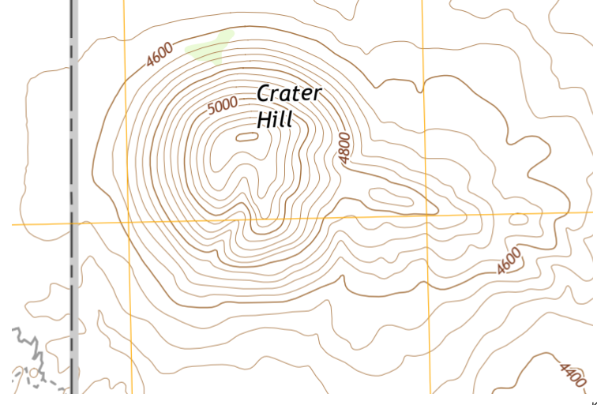
Highest Point
1
2
5
3
4
USGS MAP
Notes:
Sometimes people need to know the highest elevation of an area. How can we use our knowledge of index contour lines and calculation of contour intervals to find the answer?
Let’s look closely at this map and make some observations:
The higher points on the map go towards the center of the circle from the 5000 index contour line. See the green spot? That marks the high point of the hill.
Look closely at the index lines leading away from this center area and you will see the elevation gets lower moving away from the center. Therefore, to calculate the highest point of Crater Hill we need to count the lines from 5000 to the center. There are 5 lines counted here. Remember we already calculated that each contour line is 40 ft.
What is the elevation of line #1 on this map? 5040 ft #2? 5080 ft #3? 5120 ft #4? 5160 ft #5? 5200 ft
By adding 40 ft. for each line counted, what is the approximate highest point on Crater Hill?
More than 5200 ft. but less than 5240 ft.
Why do we know it is less than 5240 ft? Because there would be another contour line- it would be an additional 40 ft of elevation

Slide 17
Lowest Point
USGS MAP
Notes:
The lower points on this map are moving away from the center of the circle. From this, we can see that the lowest contour line is at 4400 ft.

Slide 18
Steepest Point
Notes:
The steeper parts of a topographic map are shown where the contour lines are closer together. Since there are so many contour lines so close to one another we know that elevation changes in a small area. Compare this steep area highlighted here to the next slide where the highlighted areas have contour lines much further apart…

Slide 19
Flattest Point
USGS MAP
Notes:
The land is flatter where the contour lines are farther apart. These blue areas are also lower than the previous lines…How do we know? Because the index contour lines tell us the elevation. Study the blue highlighted areas and compare to the steeper areas.

Slide 20
Flattest Point 2
STEEP
FLAT
FLAT
STEEP
FLAT
USGS MAP
Notes:
Let’s think for a moment about a natural occurrence- rain and water flow- that can also help us use a topographic map. If rain were to fall on top of Crater Hill, do you think the water would
flow up towards the center from the flatter and lower area of the outer edge? or (B) down from the center where it is higher and steeper? B! Down from the higher area
Understanding how water naturally flows on land helps a map reader determine which way a river or creek is flowing.

Slide 21
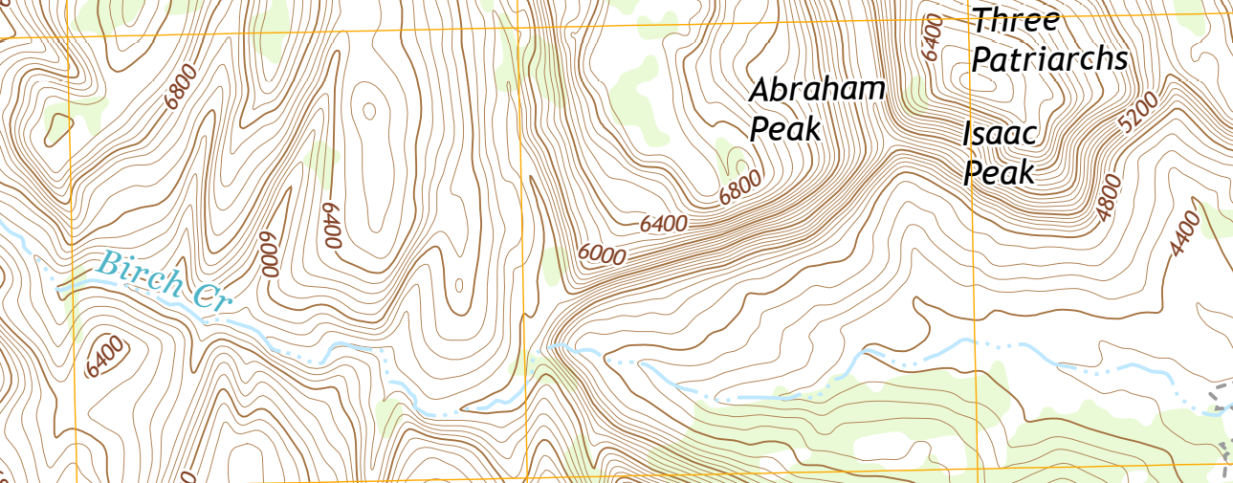
Stream Flow Direction
USGS MAP
Notes:
For a person hiking, boating, or even planning to build near a stream it’s important for them to know which way the water will flow. Water always flows downhill or to lower elevation. This pull of gravity on water helps us look at a topographic map and determine which way a stream flows too. Water always flows from a point of higher elevation to lower elevation.
Here’s a scenario: You will be hiking the area in the map and your directions tell you to follow Birch Creek downstream. Which direction should you walk? Read on for some big hints.
Find Birch Creek on the map where the red arrow points. What is the elevation of this index contour line? 5200 feet. Follow the creek to the right as it passes over other index contour lines. Are these lines labeled higher elevation or lower elevation than 5200 ft? Lower. Is the creek flowing right or left with this information? Birch creek flows to the right because the elevation that direction is lower than 5200 ft!

Slide 22
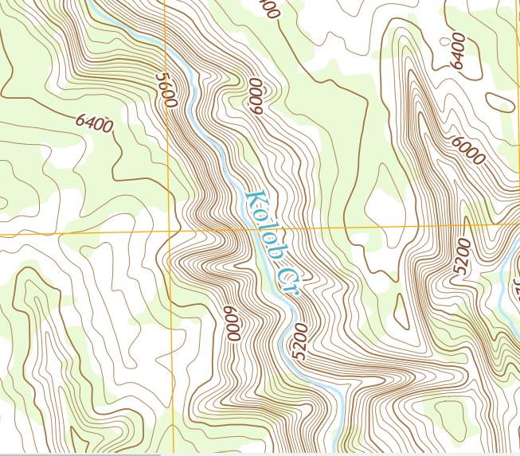
Stream Location
USGS MAP
Notes:
Here is another creek in Zion National Park named Kolob Creek. Find the red arrow. This time let’s try to visualize what the land around the creek looks like by studying the space between contour lines. Earlier we learned that lines that are far apart represented land that is flat or gently sloped. Are the contour lines in this example far apart or close to one another? They are very close. With this information, what do you think the creek bank that surrounds the creek in this spot looks like? High rock walls or flat, level land? If you were hiking along this creek, would it be easy or difficult to get out of the creek area if there was a flood?
Let’s take a look at a photograph of Kolob Creek to see if you’re correct…

Slide 23
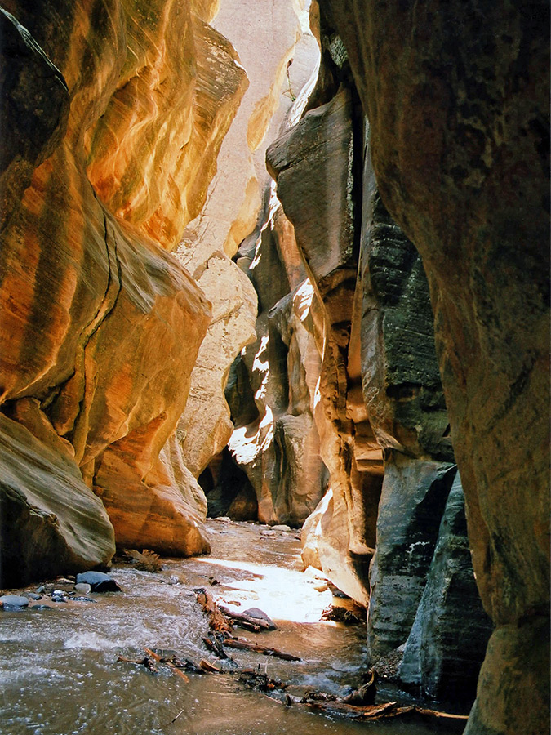
The Narrows
Notes:
The land surrounding the creek is very steep! In fact, Kolob Creek is at the bottom of a slot canyon! Slot canyons are an example of a landform created by swiftly moving water and the process of erosion.
Would it be safe to hike Kolob Creek on a day when the weather forecast predicted rain? No way. Rain water would flood the canyon and the steep walls would make it impossible to escape.

Slide 24
Why are topographic maps important?
Notes:
Reading and analyzing information on a map in order to use that information in your every day life is important and even fun. Some people use topographic maps when enjoying the outdoors- hiking, rock climbing, hunting, or canyoneering. Knowing how the land actually lays and looks enables people to plan routes more safely or travel more quickly.
However, topographic maps are also used in our daily lives all the time in ways we might not notice. Topographic maps are used for planning where to place buildings, roads, bridges, and even mines for extraction of resources. How might you use a topographic map in the future?

